Slide 1

Welcome to my Capstone Presentation

Slide 2
1. What age will I be at my physical peak?
Explore data on professional athletes
2. What sport would I naturally be best at?
The Sport Recommender Model

Slide 3
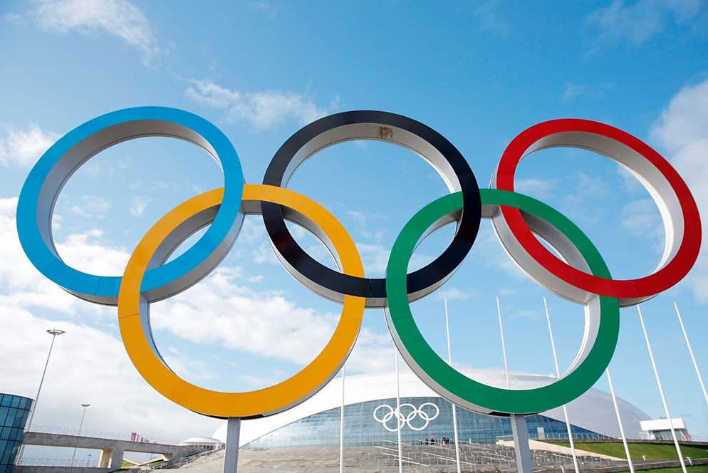
My Dataset
Olympic Athletes 1896-2020
Sports the athletes competed in.
Is it a physical sport?
Is it a team sport?
Personal Attributes:
Age
Height
Weight
Gender

Slide 4
1. What age will I be at my physical peak?
26
There are factors we must consider:
The average age of athletes has likely changed between 1896 and 2020
Not all Olympic sports require peak physicality and athleticism (e.g. Golf).
There may be other factors (such as height and weight).
(The average age of ALL athletes in my dataset)

Slide 5
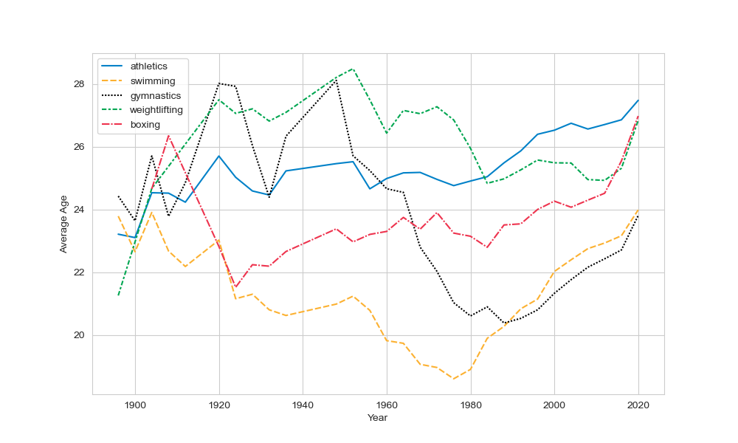
1. What age will I be at my physical peak?
The Age of Athletes through the years
This line graph shows the average age of athletes in 5 physically demanding sports at every Olympics from 1896-2020.
Key Point:
The average age has fluctuated A LOT through the years!
Need to focus on the most recent data.

Slide 6
1. What age will I be at my physical peak?
The Age of Athletes through the years
This line graph shows the average age of athletes in 5 physically demanding sports at every Olympics from 1896-2020.
Key Point:
The average age clearly depends on the Olympic sport.
Need to do more research and analysis to understand why this is the case.

Slide 7
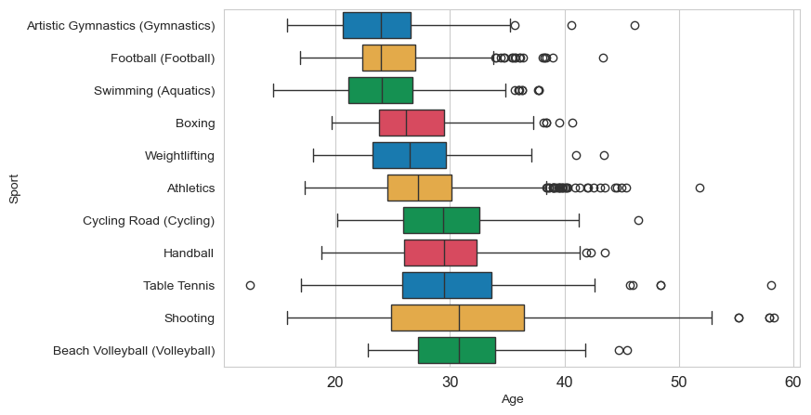
1. What age will I be at my physical peak?
Age Distribution of Olympic Athletes (2020)
Non-Physical Sports
(e.g. Table Tennis, Shooting)
The median age of non-physical sports are high.
Table Tennis median age = 29.5
Shooting median age = 30.8
But we want to look at physical sports.

Slide 8
1. What age will I be at my physical peak?
Age Distribution of Olympic Athletes (2020)
Physical Team Sports
High median age for these sports.
BUT WHY?
TEAMWORK: The physical demand of the sport is spread across the team.
EXPERIENCE: Team sports require a high-level of game reading and strategic thinking which comes with experience.
Football median age = 24
This is unrepresentative!

Slide 9
1. What age will I be at my physical peak?
Age Distribution of Olympic Athletes (2020)
Physical Individual Sports
The median age of physical individual sports are lower.
WHY?
IT MUST BE BECAUSE THE ATHLETES IN THESE SPORTS ARE AT THEIR PHYSICAL PEAK!
But why is the median age for swimming 3 years younger than athletics?

Slide 10
1. What age will I be at my physical peak?
Age Distribution of Olympic Athletes (2020)
Sport | Median Age
Gymnastics | 23.9
Swimming | 24.0
Boxing | 26.1
Weightlifting | 26.5
Athletics | 27.2
Why is the median age for swimming 3 years younger than athletics?
DIFFERENT PHYSICAL DEMANDS
Swimming/Gymnastics:
Agility
Flexibility
Easier to get injuries.
Technical demands are hard to maintain.
Athletics/Boxing/Weightlifting
Strength
Power
Develop at an older age.
Requires more endurance.

Slide 11
1. What age will I be at my physical peak?
?
It is impossible to get an exact number,
AND it is probably different for everyone.
My research and analysis implies 24-27 years.
BUT that is for Olympic athletes.
I will be at MY physical peak when I am at my most active!

Slide 12
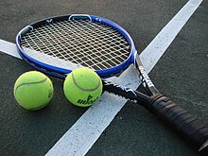
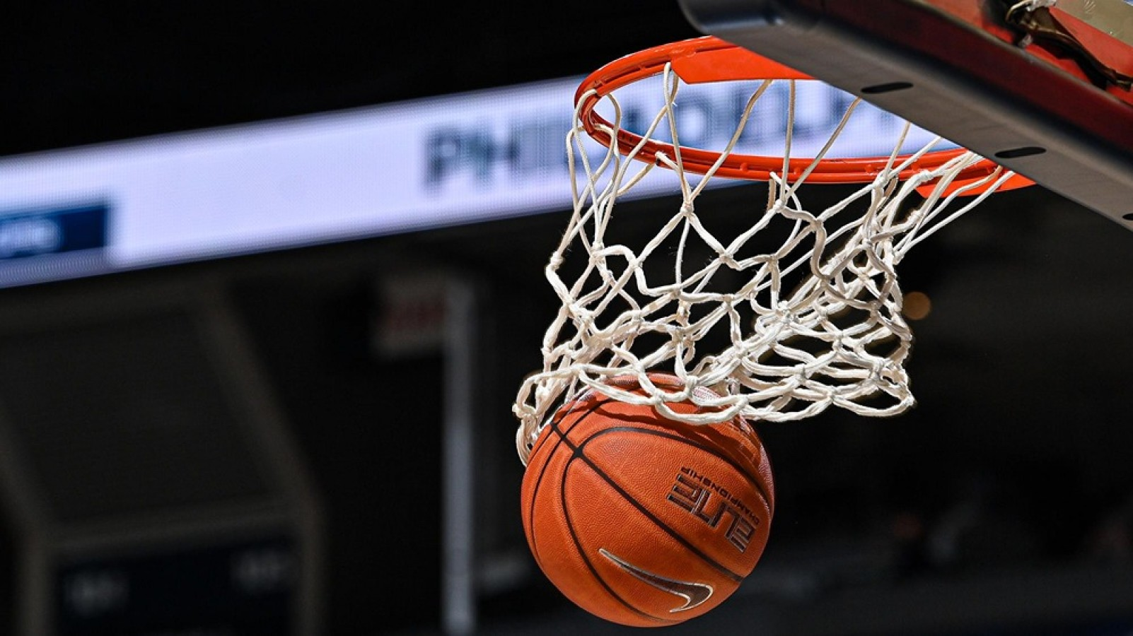
2. What sport would I naturally be best at?

Slide 13
2. What sport would I naturally be best at?
Factors
What factors affect what sport I would naturally be best at?
Age
Height
Weight
Gender
Personal preferences:
Would I prefer a more physical sport?
Would I prefer a team sport?
Features

Slide 14
2. What sport would I naturally be best at?
Features
Target
Age
Height
Weight
Gender
Physical sport?
Team sport?
Olympic Sport
It’s time to make a model!

Slide 15
2. What sport would I naturally be best at?
The Sport Recommender Model
How I created my model:
I used Olympic data from 2000-2020
I removed all Olympic football players from my data.
I split my data into a training set and a testing set.
I used a Decision Tree Classifier in Python.
I used a Grid Search to find the best hyperparameters for my decision tree.
I fit the model to my training data.
FEATURES | TARGET
Age | Olympic Sport
Height
Weight
Gender
Physical
Team

Slide 16
2. What sport would I naturally be best at?
The Sport Recommender Model
Model Performance:
The target of my model has 45 classes.
My model had 45% accuracy on the test data.
Feature Importance:
Age = 18 %
Height = 25%
Weight = 23%
Gender = 10%
Physical = 12%
Team = 12 %
FEATURES | TARGET
Age | Olympic Sport
Height
Weight
Gender
Physical
Team

Slide 17
2. What sport would I naturally be best at?
The Sport Recommender Model
Time for a demonstration!

Slide 18
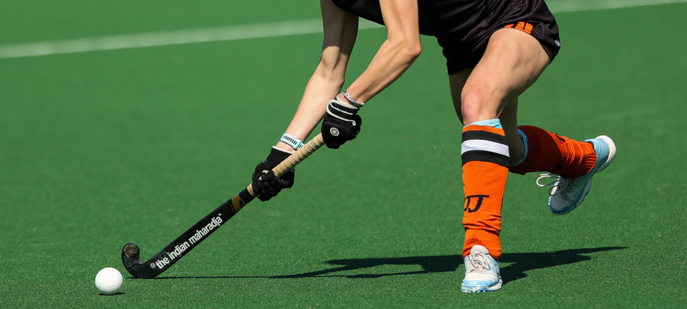
2. What sport would I naturally be best at?
Possible Improvements
How could I improve my model?
Use data from 2024 Olympics.
Add more features:
Nationality?
Give more than one recommendation.
Maybe I don’t want to play hockey!

Slide 19
1. What age will I be at my physical peak?
2. What sport would I naturally be best at?
I explored data about Olympic athletes to try and find the answer.
Olympic athletes who take part in physical individual sports have an average age of 24-27.
I am not an Olympic athlete, so this may not be true for me.
I created the Sport Recommender Model to try and answer this question.
The answer I got was hockey!

Slide 20
Thank you for listening

